Slide 1
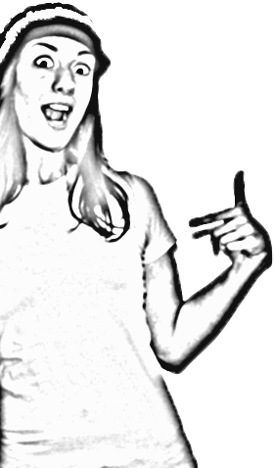
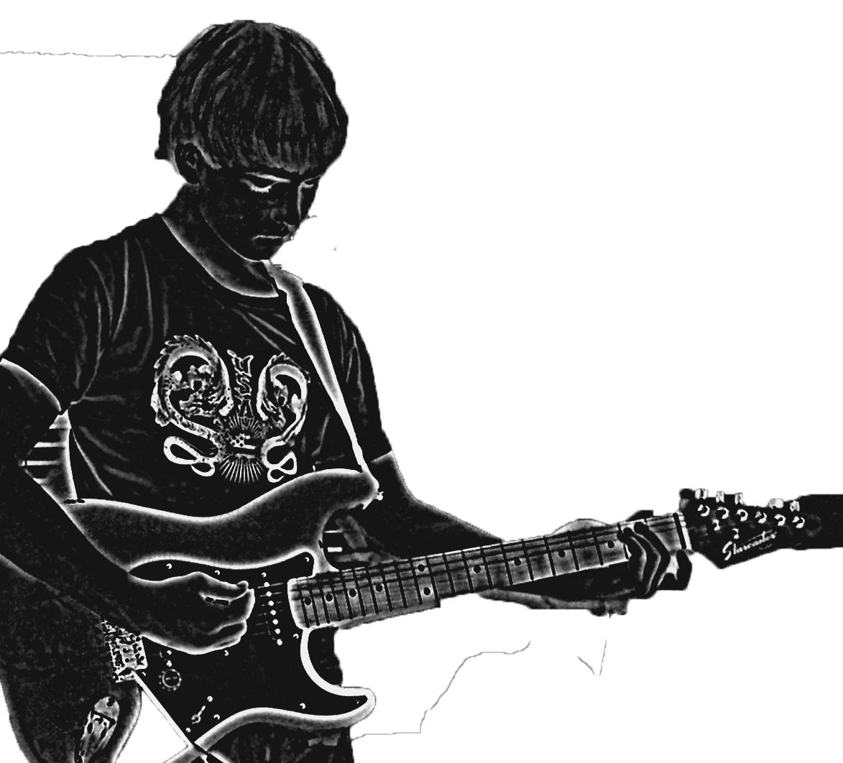
T-Shirt Design
How creative are you?

Slide 2
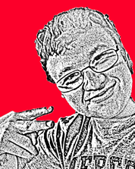
Steps to Designing Your Own Shirt
Step 1: Come up with an idea. Your idea could be an illustration or a slogan.
Step 2: Complete some thumbnail sketch ideas of your design, until you come up with one you like.
Step 3: Create your design in Adobe Photoshop or Adobe Illustrator.
Step 4: Create a presentation for your design.
Step 5: Turn your final design in.

Slide 3
Step 1
In your notes please write down a minimum of three ideas.
For example:
I want to do a shirt design for kids that represents the slogan “3 Caballeros”
I want to do a design for the quote, “Life is a Bowl of Cherries.”
I want to do an illustration of the city.
Come up with an idea. Your idea could be an illustration or a slogan.

Slide 4
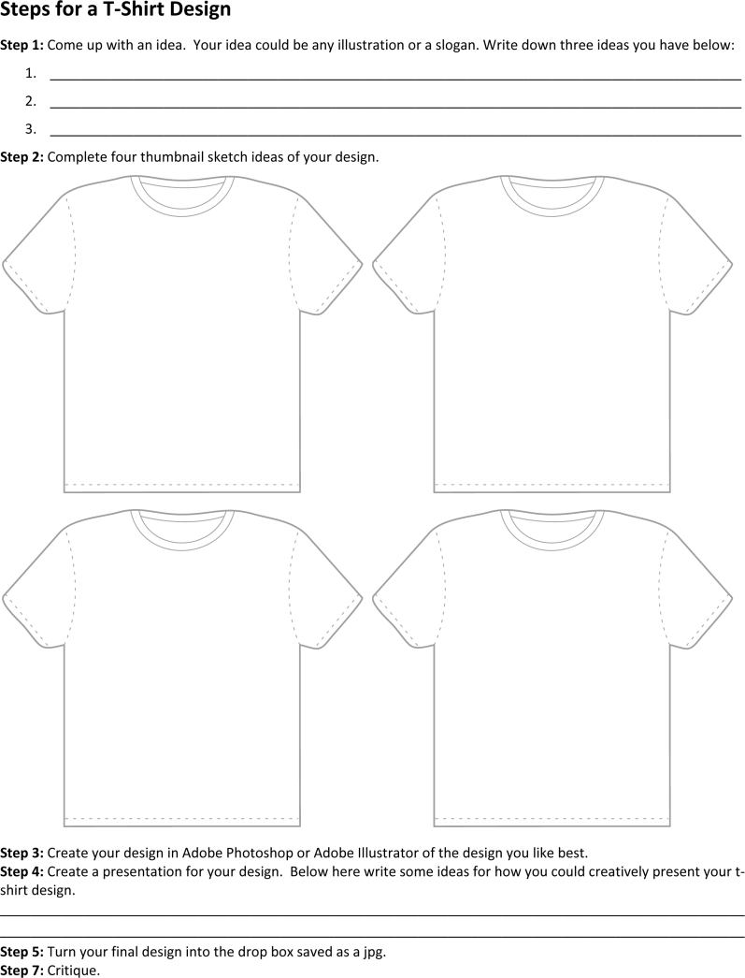
Step 2
In your notes please complete four thumbnail sketches of design ideas for your t-shirts.
Complete some thumbnail sketch ideas of your design, until you come up with one you like.

Slide 5
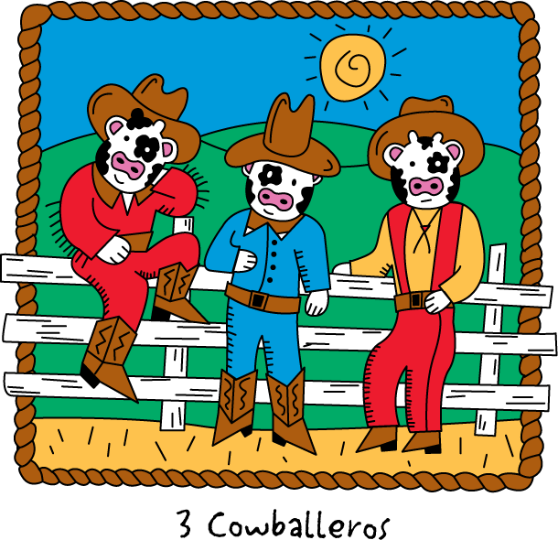
Step 3
You will need to choose which program will work better for your design.
Create your design in Adobe Photoshop or Adobe Illustrator.
Your design must be:
A minimum of 150 dpi at the size it will be printed
No more than 8 spot colors
No larger than 15" x 20"

Slide 6
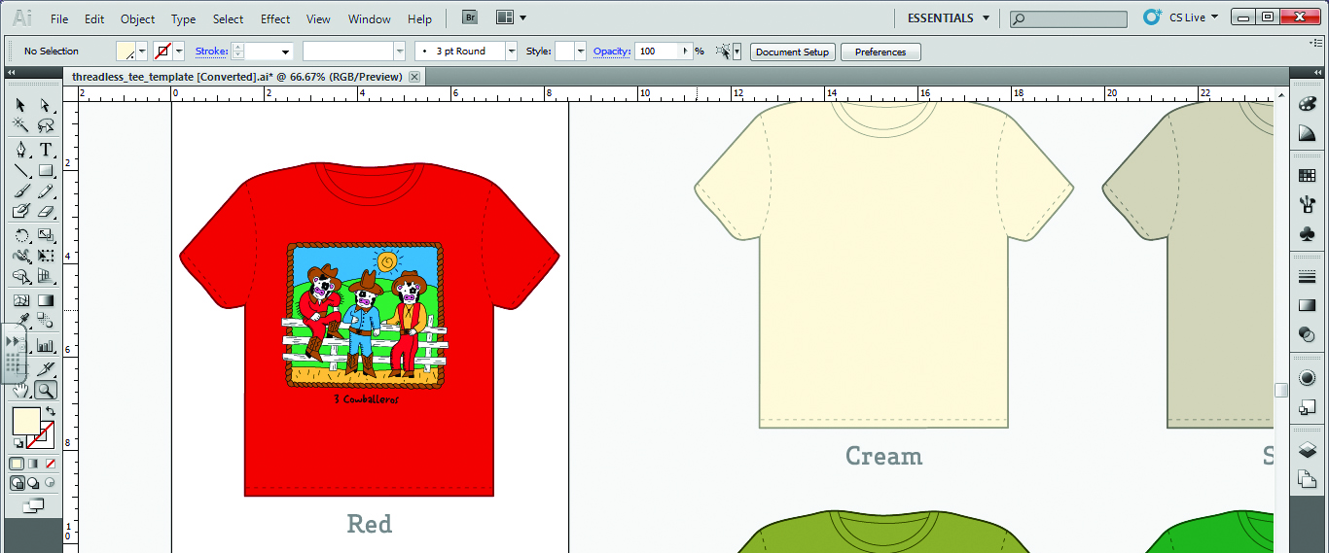
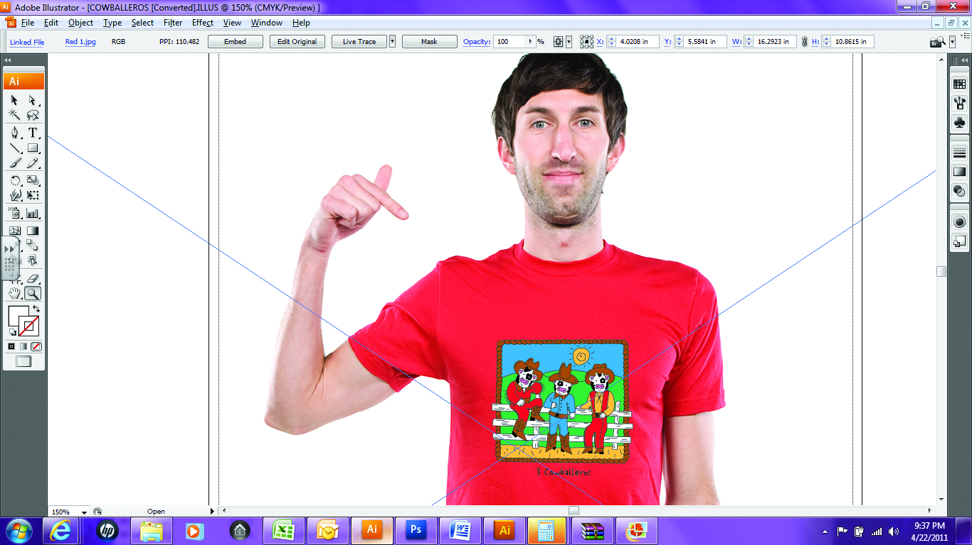
Step 4
You can either choose a template of a t-shirt in Illustrator or Photoshop.
Or you can put it on an actual photo of a person in a shirt.
Think about how you can creatively present your shirts like the ones you saw earlier in the presentation.
Save your original file!
Then copy your artwork to one of tee templates located in the assignments folder. You can add to your design to make your presentation more interesting

Slide 7
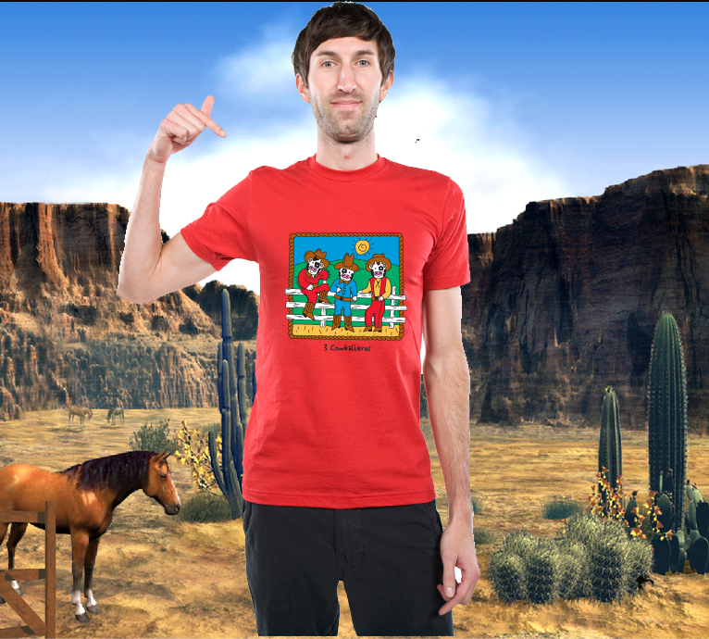
Step 5
Save your final artwork in.

