Slide 1
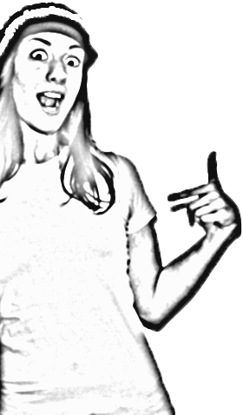
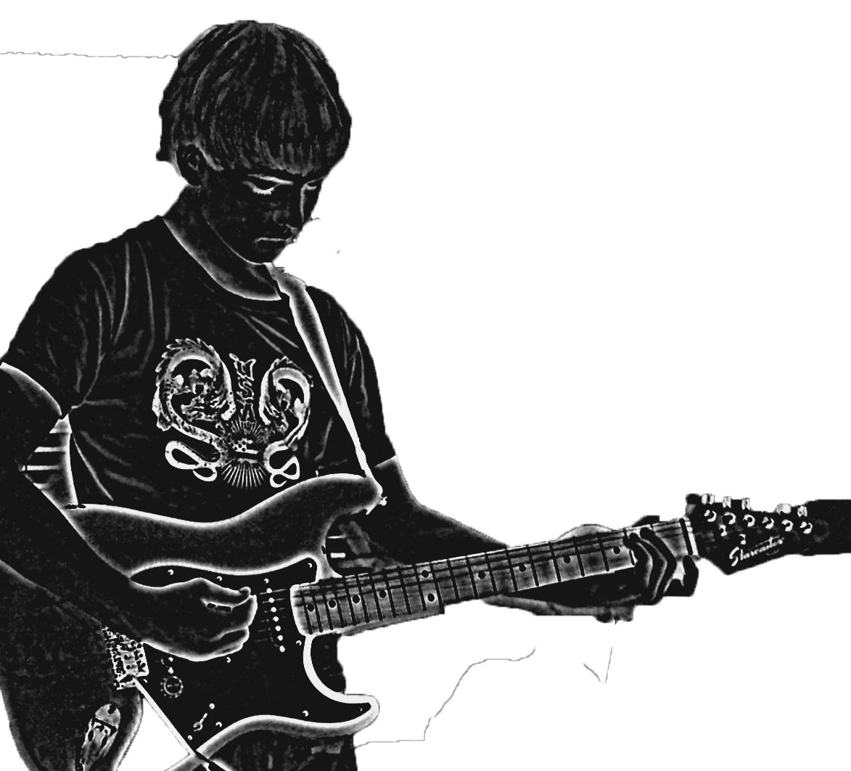
T-Shirt Design
How creative are you?

Slide 2
Evaluating T-Shirt Designs
You are going to be shown four t-shirt designs. You will work with a partner to evaluate the designs based on:
What stands out most when you first look at the designs?
Does the design have a clear concept?
How does the artist use the elements of art and principles of design to lead the eye?
How does the artist use color to add to the feeling of the design?
Who is the target audience for these designs? Does the design appeal to that audience?
How does the presentation of the shirt make it more appealing?
Does the design look high quality?
Could the artist do anything to make this design more successful?
Which is your favorite? Why?

Slide 3
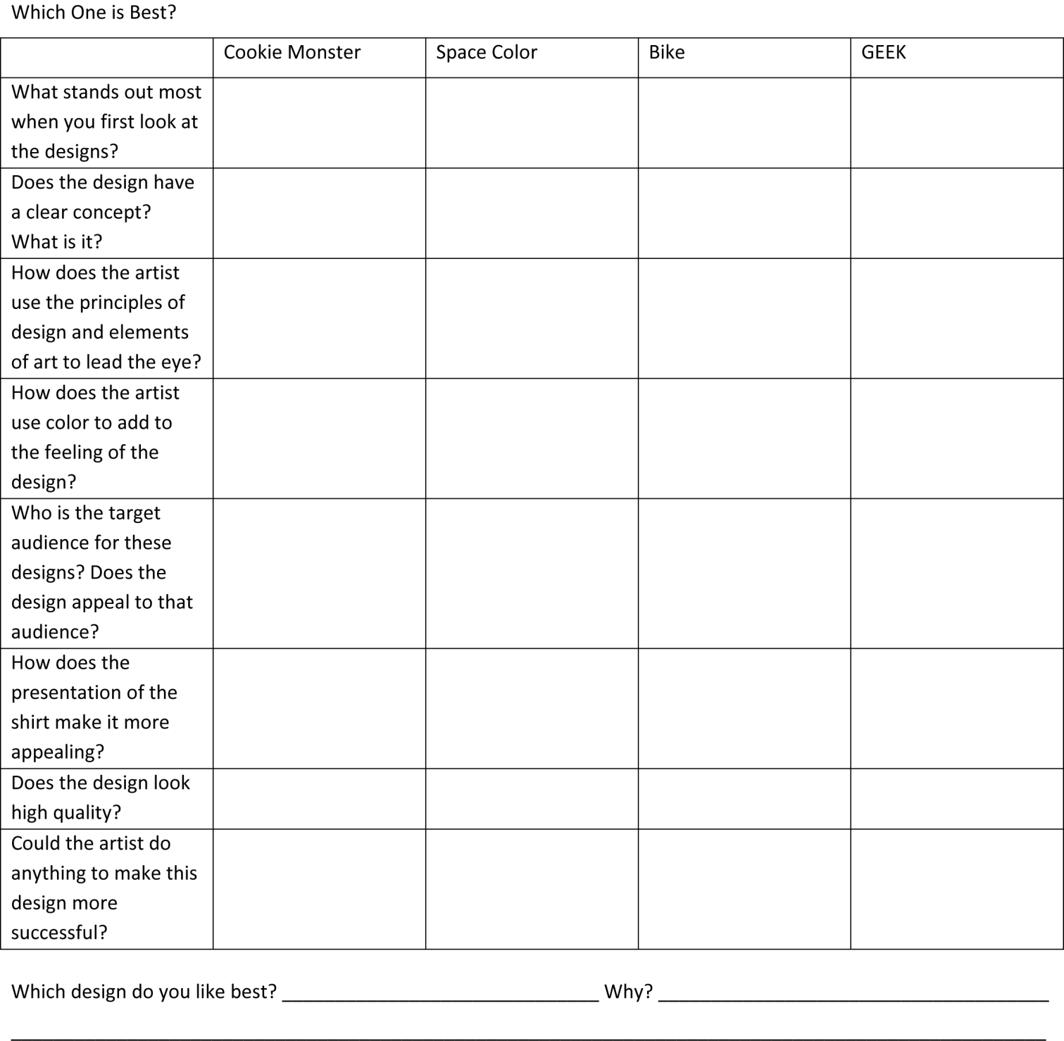
Will evaluate the designs using this table in your notes form.

Slide 4
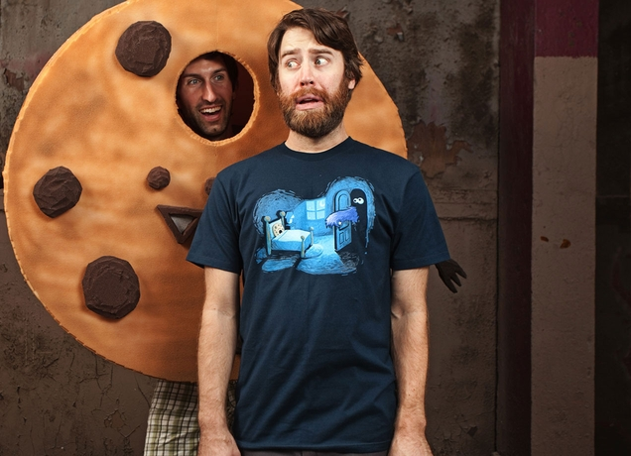
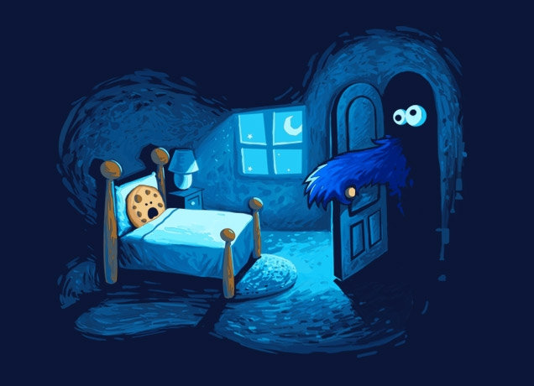
Let’s Look at Some Shirt Designs and Decide
Which One is Best?
Monster in the Closet byEfrem Palacios

Slide 5
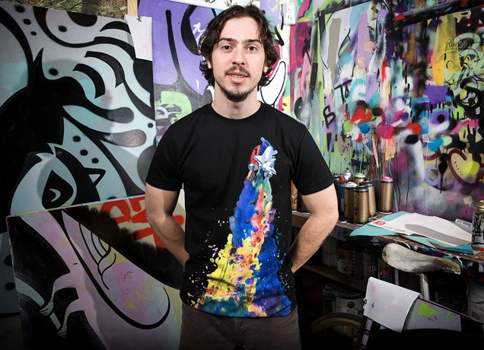
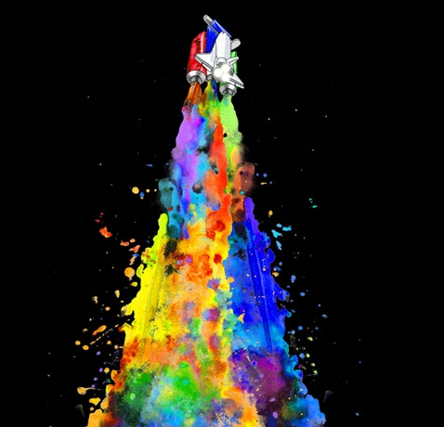
Let’s Look at Some Shirt Designs and Decide
Which One is Best?
Does the design appeal to the target audience? (Who is the target audience?)
Does the design have a clear concept?
Are the elements of art and principles of design used to support the design and the message/mood of the design?
Does the design look high quality?
Is the design created in a high quality format?
Is design presented creatively?
Space Needs Color
by Alvaro Arteaga Sabaini

Slide 6
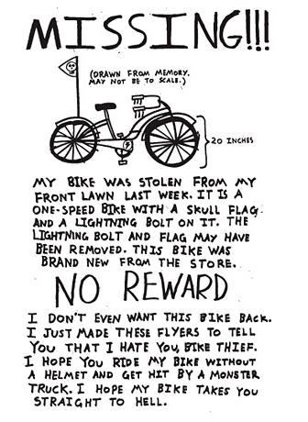
Let’s Look at Some Shirt Designs and Decide
Which One is Best?
Does the design appeal to the target audience? (Who is the target audience?)
Does the design have a clear concept?
Are the elements of art and principles of design used to support the design and the message/mood of the design?
Does the design look high quality?
Is the design created in a high quality format?
Is design presented creatively?
Missing!!!Designer by Julian Glander

Slide 7
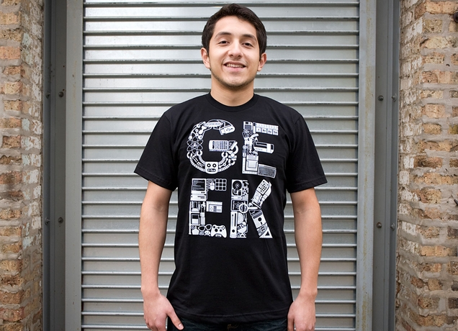
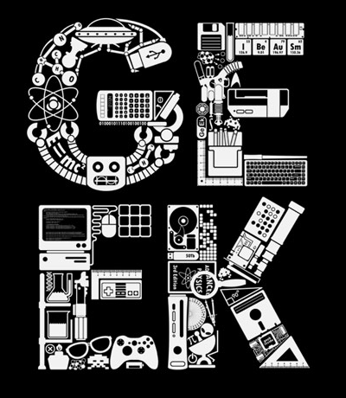
Let’s Look at Some Shirt Designs and Decide
Which One is Best?
Does the design appeal to the target audience? (Who is the target audience?)
Does the design have a clear concept?
Are the elements of art and principles of design used to support the design and the message/mood of the design?
Does the design look high quality?
Is the design created in a high quality format?
Is design presented creatively?
I Be Au Sm Designer by Lawrence Villanueva

Slide 8
Your Turn
You have five minutes. Go to threadless.com and find your favorite design. Put your design up on your screen and we will all look at them.
Objective: Students will create a t-shirt design that communicates an idea, theme or emotion.

